Slide 1
Imaging in the Information Dimension
Suhas Somnath
Chris R. Smith
Stephen Jesse

Slide 2
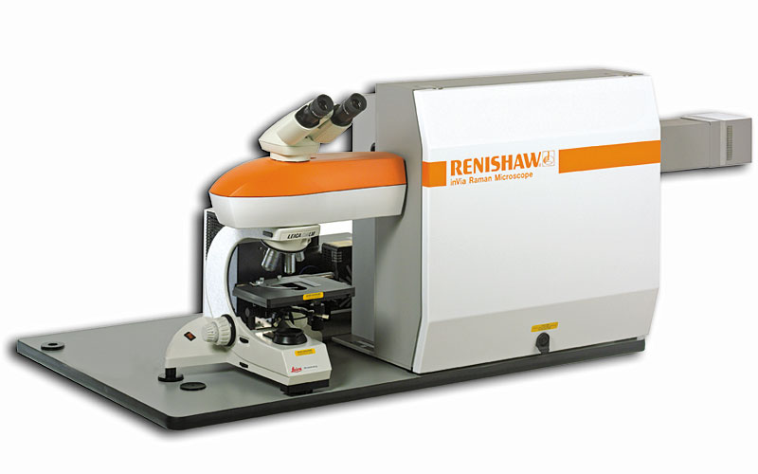
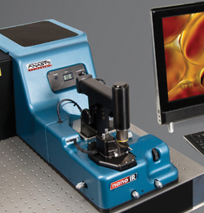
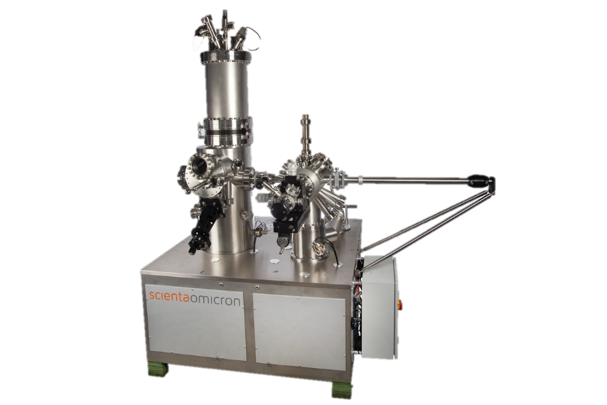
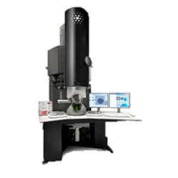
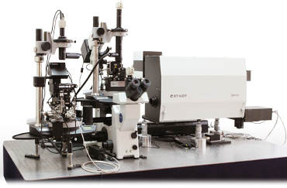
Multitude of Instruments
Micro Raman Microscope
Atomic Force Microscope (AFM)
AFM with Infrared spectroscopy (AFM-IR)
Scanning Tunneling Microscope (STM)
AFM with Raman spectroscopy
Scanning Transmission Electron Microscope (STEM)

Slide 3

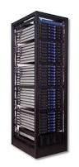
What we wanted
Interactive visualization, analysis, storage on supercomputers
Instrument Tier
?
Notes:
Solution becomes apparent after truly understanding the problems

Slide 4
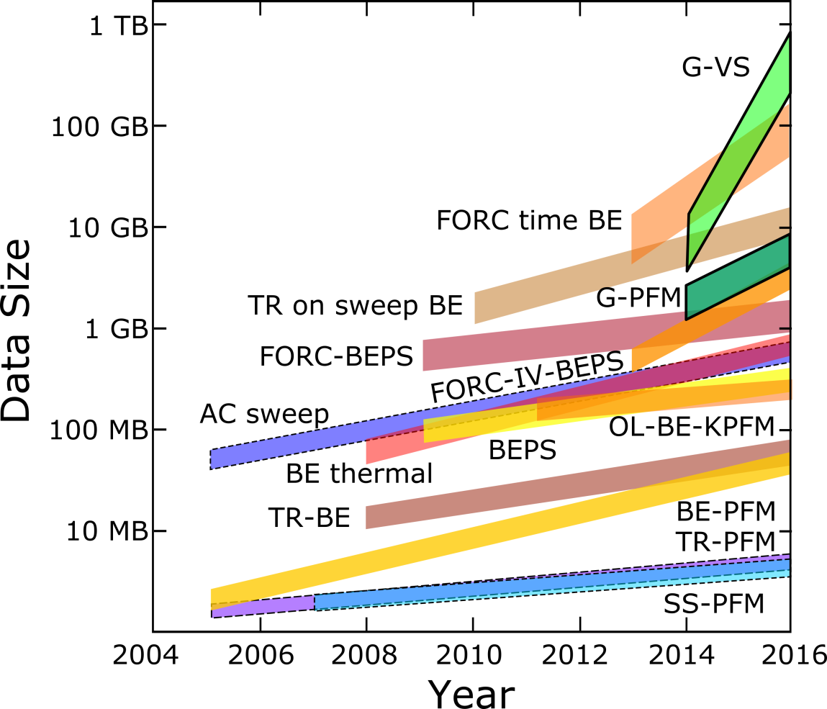
Growing Data Sizes and Dimensionality
Evolution of Scanning Probe Microscopy Data
Data sizes have grown from ~ 10 MB to ~ 1 TB in 10 years!
Dimensionality ranges from 1D spectra to 7D hyperspectral datasets
Cannot use laptops to analyze data
Kalinin et al., ACS Nano, 9068-9086, 2015

Slide 5
Instrumentation Software Inadequate for Analysis
Software provided for controlling instruments typically only comes with basic data analysis capabilities
Integrating user-developed functionality often impossible

Slide 6
Multitude of File Formats
.wdf
.ibw
.cdb
Proprietary
Incompatible
.mat
.asc
.dm3

Slide 7
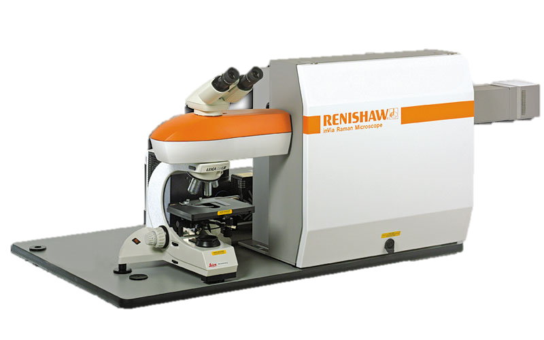
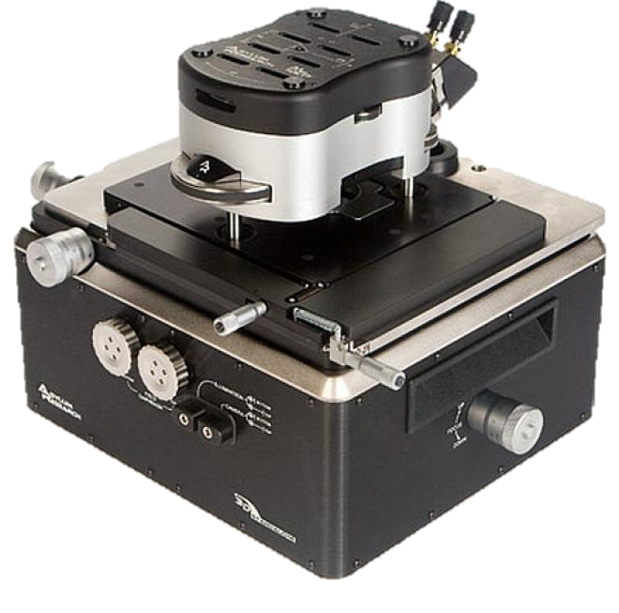

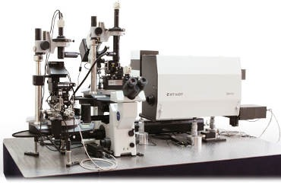
Disjoint & Unorganized Communities
Clustering
Fit spectra …
Filter Image
Register Image …
Fit Spectra
SVD Filtering …
FFT Filtering
SVD Filtering …
FFT Filtering
Classify Images …
Register Images
Clustering

Slide 8
Cannot Share Code Efficiently
Clustering
Fit spectra …
Filter Image
Register Image …
Fit Spectra
SVD Filtering …
HIGHLY instrument-specific code
Different programming languages
Often licensed / costly software like Matlab
Most popular sharing method = email!
No centralized repository
FFT Filtering
SVD Filtering …
FFT Filtering
Classify Images …
Register Images
Clustering

Slide 9
Problems Opportunities in Imaging
Closed science
No traceability for data analysis
Results not (readily) reproducible
Multiple, incompatible, proprietary data formats
Disorganized and unorganized communities
No proper analysis software
Growing data volumes, variety, and dimensionality

Slide 10

The Solution
Automated, standardized, modularized data acquisition
Instrument-agnostic, self-describing, model in HPC-friendly file format
Centralized repository for data processing, analysis
Interactive visualization + analysis + storage on supercomputers
Instrument Tier

Slide 11
Expectation of Data Model
Accommodate data of different shapes, dimensionalities, precision and sizes.
Accommodate data without N-dimensional form
Compressed sensing / sparse sampling
Not all combinations of spectroscopic variables
Incomplete experimental data

Slide 12
Universal Imaging and Spectroscopic Data (USID)
Data stored as 2D matrix of (position x spectral values) regardless of dimensionality
Ancillary datasets explain the data
Example data types:
2D images = (N_{pixels} x 1)
Single spectra = (1 x Z_{steps})
Spectroscopy on grid = (N_{pixels}x V_{steps})
Position Values
Position Indices
Measurement / Analysis parameters→
Attribute A
…
Attribute Z
Time / Spectral →
←Location
2D Matrix for an Entire Spectral-Image Chunked by outermost position loop.
These results have been already normalized by the excitation band
Main Dataset
Spectroscopic Indices
Spectroscopic Values
Detailed information on pyUSID website

Slide 13
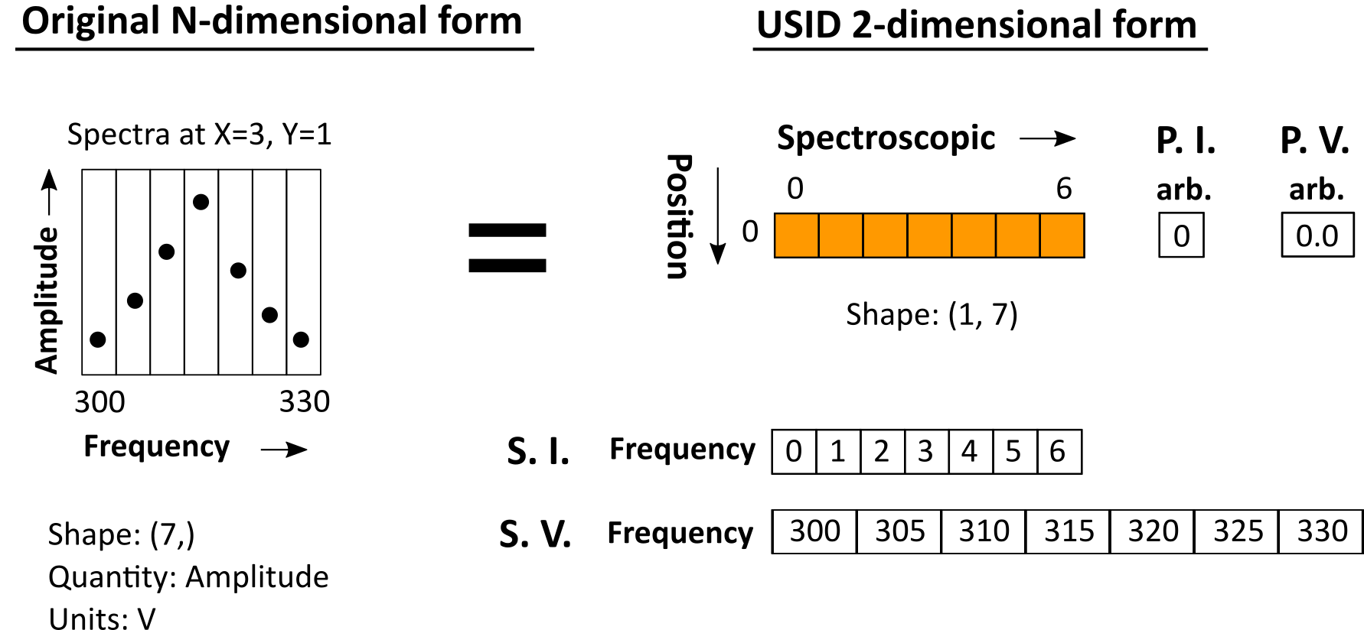
USID – 1D spectra

Slide 14
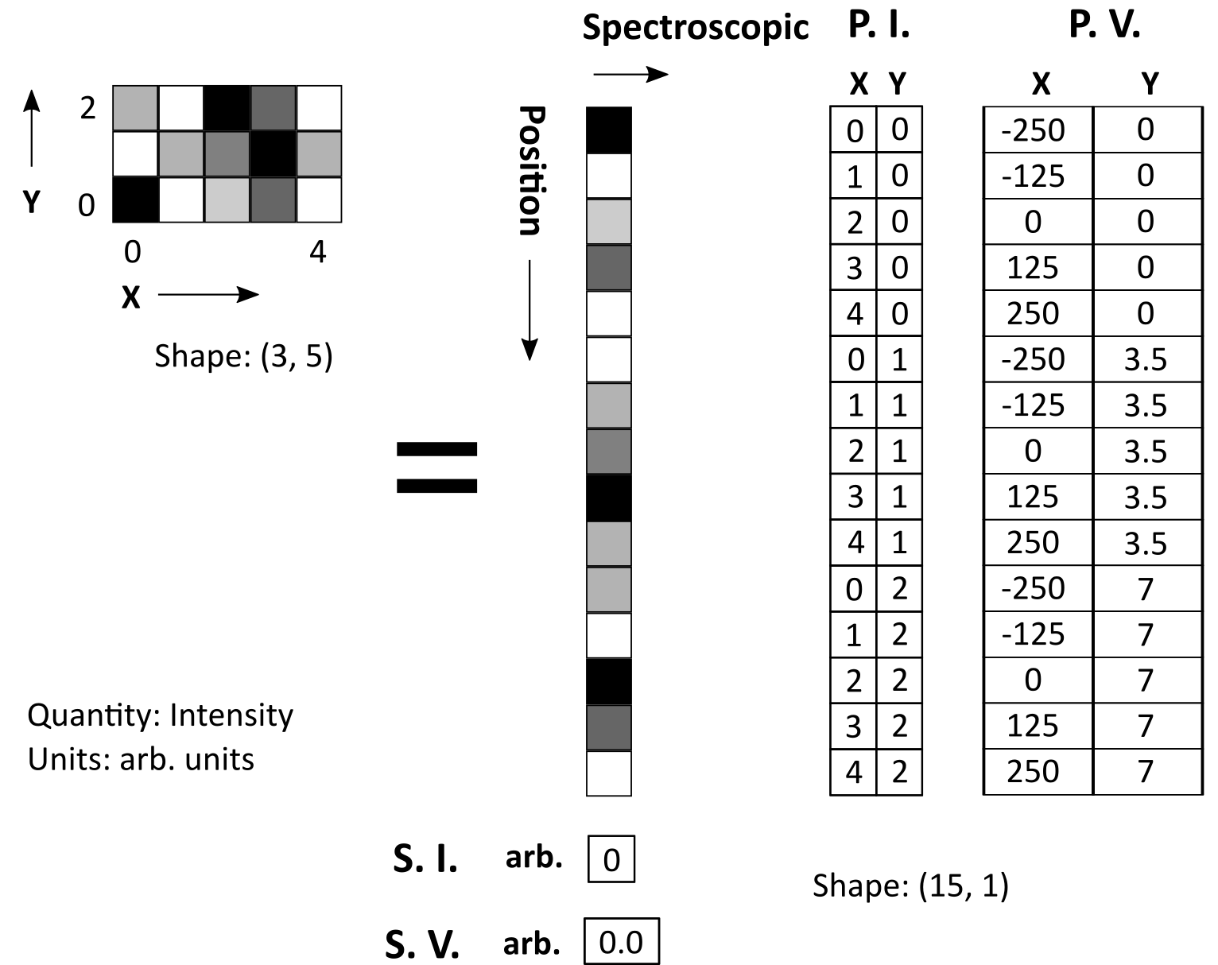
USID – 2D Image
USID 2D form
Original N-D form

Slide 15
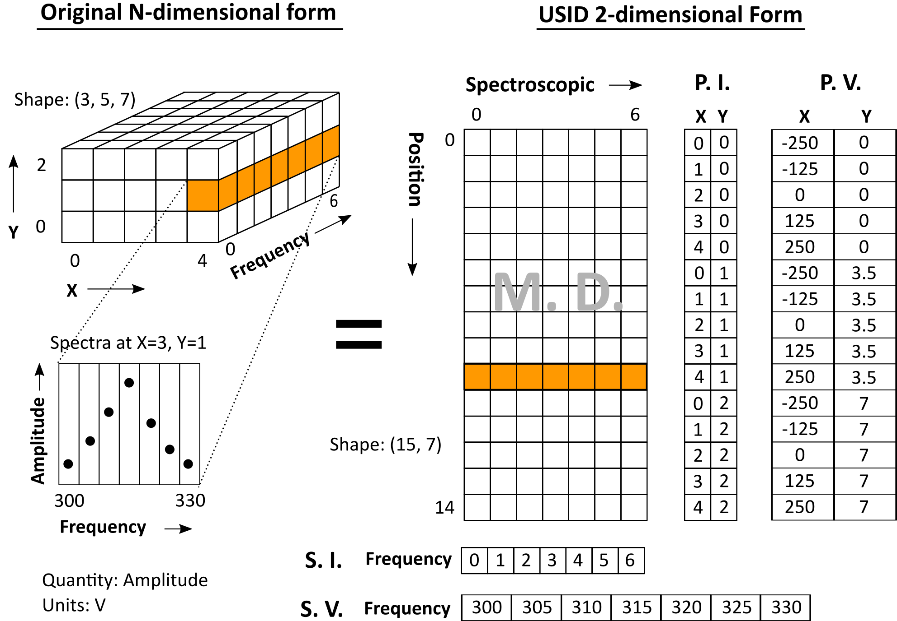
USID – Spectra on Grid (3D)

Slide 16
USID - Instrument Agnostic Code
Instrument-agnostic data allows instrument-agnostic code
Single version of analysis and processing routine
Brings multiple scientific communities together
SPM
Multispectral imaging
FFT filtering
Functional fitting
STM I-V spectroscopy
Decomposition
STEM
ptychography
Clustering

Slide 17
Expectation of File Format
Established standard in scientific research
Store multiple datasets of different shapes, dimensionalities, precision and sizes.
Scale very efficiently from few kilobytes to several terabytes
Able to read and write data using any programming language including Python, R, Matlab, C/C++, Java, Fortran, Igor Pro, etc.
(without requiring installation of modules that are hard to install)
Store metadata - experimental or analysis parameters
Highly flexible and poses minimal restrictions on how the data can and should be stored.
Compatible with cloud and high-performance computing paradigms (support parallel read and write)

Slide 18

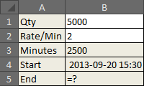
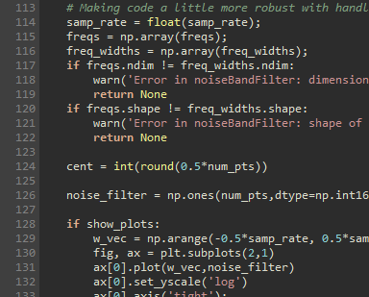
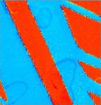
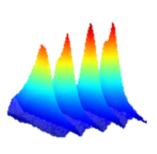

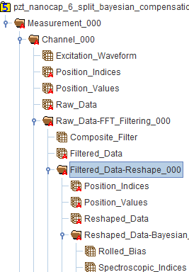
Hierarchical Data Format (HDF5)
A HDF5 file is a smart container
Capable of storing multidimensional datasets, Images, text, measurement parameters, etc.
Contents organized like traditional folders and files
Groups - Analogous to file folders
Dataset – 1 to N dimensional data
Integer, floating point, complex numbers etc
Attributes – {Key : value} pairs useful for describing data and experimental parameters, etc.
Easily accessible – C, C++, python, Java….
Tree structure + nomenclature +attributes are records of workflow applied to dataset
Parallel read / write, HPC & cloud compatible

Slide 19
Expectation from Software
Easy to learn and understand
Strong support-base
Established community standard
Straightforward to implement and maintain
Optimized libraries for scientific and numeric algorithms
Access to existing imaging related packages
Free
Scalable to multiple CPU cores + distributed computing

Slide 20


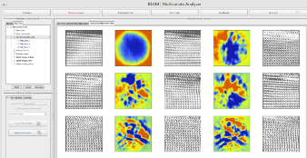
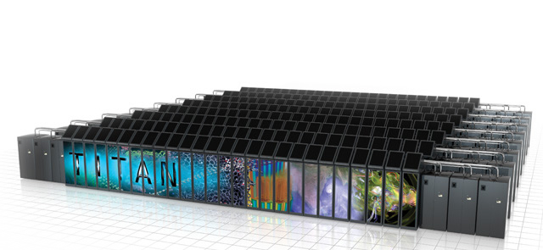

(Purely) Programmer-Driven Solution
Software connecting scientific instruments to supercomputers
Successes:
Easy to use – Point-click
Fast – on super-computers
Shortcomings:
Very long development cycle
Very expensive
Brittle (points of failure)
Scientists had no control!!
Scientific Data Center
High Performance Computing
Interface/Visualization Tier
Access from anywhere
Supercomputing
Web and
Data Server
Compute Resource
Logic Tier
Parallel Data
Analysis Routines
PHP Web Service
& Serial Data Analysis
HTTPS
Data Tier
MySQL
Database
Data
& Artifacts
LOCAL
Scientific Instrument Tier
CNMS Resources
High Speed Secure Data Transfer
Supercomputing Tier
Scanning Transmission
Electron Microscopy (STEM)
Scanning Probe Microscopy (SPM)
Lingerfelt et al., Procedia Computer Science 80, 2276-2280 (2016).
Notes:
BEAM is a prime example of one of the workflows developed completely in-house to enable near real-time analysis of materials science data by establishing a connection between microscopes and neutron sources and OLCF and CADES computing reosurces
It takes care of data management, storage, communicating with supercomputers and the microscopes, getting the parallel computing done and presents the users with a light Java based client that can be accessed anywhere in the world to control the data management and analysis.

Slide 21







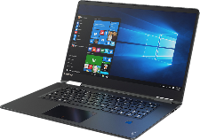

Python for Scientific Research
Very easy to learn + code
Facilitates innovation
More robust code
Improved adoption of new methods / standards
Numerous, powerful libraries for science
Accelerates scientific progress
Cross-platform
scalable
Established standard for:
Microscopy
Microbiology
Deep learning
Data science
Neutron science
More !
Strong user community
All for a princely sum of …. $0!
See Jake Vanderplas’ Pycon 2017 Keynote talk:
http://www.youtube.com/watch?v=ZyjCqQEUa8o&t=19m20s

Slide 22
(2) Software Packages
Written in Python
Open source & free
Written by scientists
Data centric
Instrument-independent data model in HDF5
Instrument-independent analysis algorithms
Reusable across scientific domains
pyUSID

Slide 23
Software Organization
pycroscopy
I/O
Data translators (proprietary formats to HDF5)
Analysis
Physical model specific
Fitting to model, etc.
Physics based regression
Visualization
Plotting utilities
Jupyter widgets
Processing
Physical model agnostic
Image filtering, registration,
Multivariate analysis
Simulation
AFM Force-distance …
pyUSID
HDF5 file i/o operations
Base data processing,
visualization…

Slide 24

Software Organization
Science / data analytics applications
File / data tools
pyUSID

Slide 25
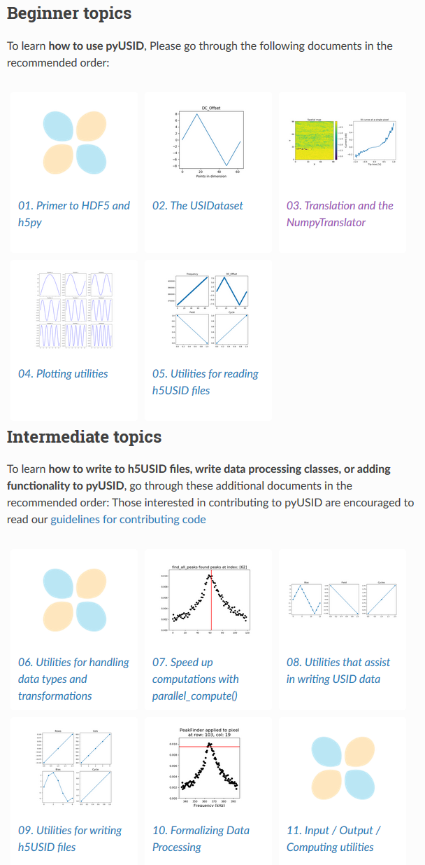
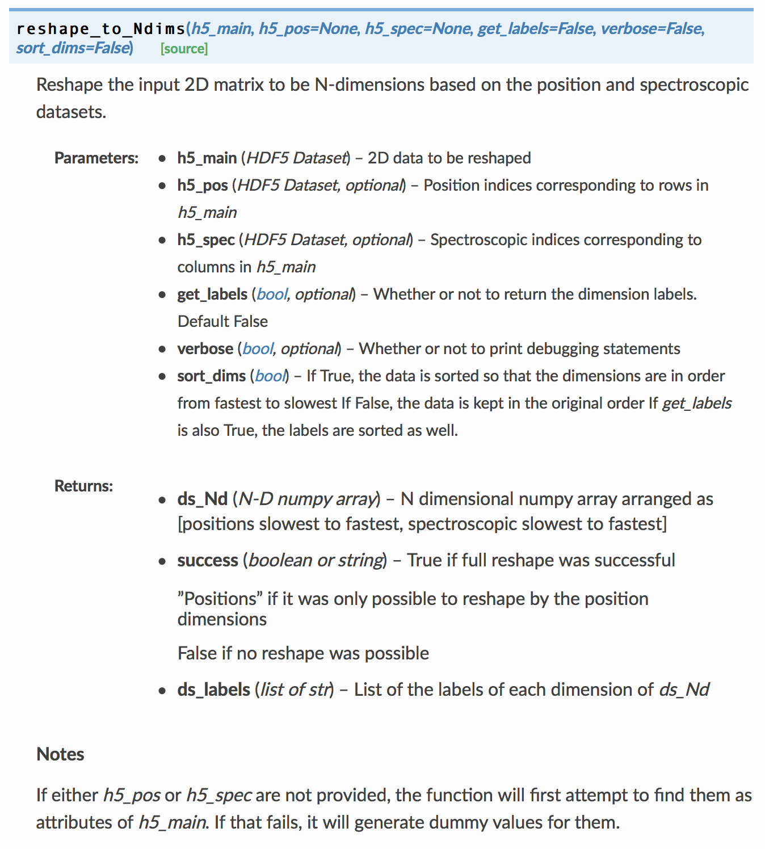
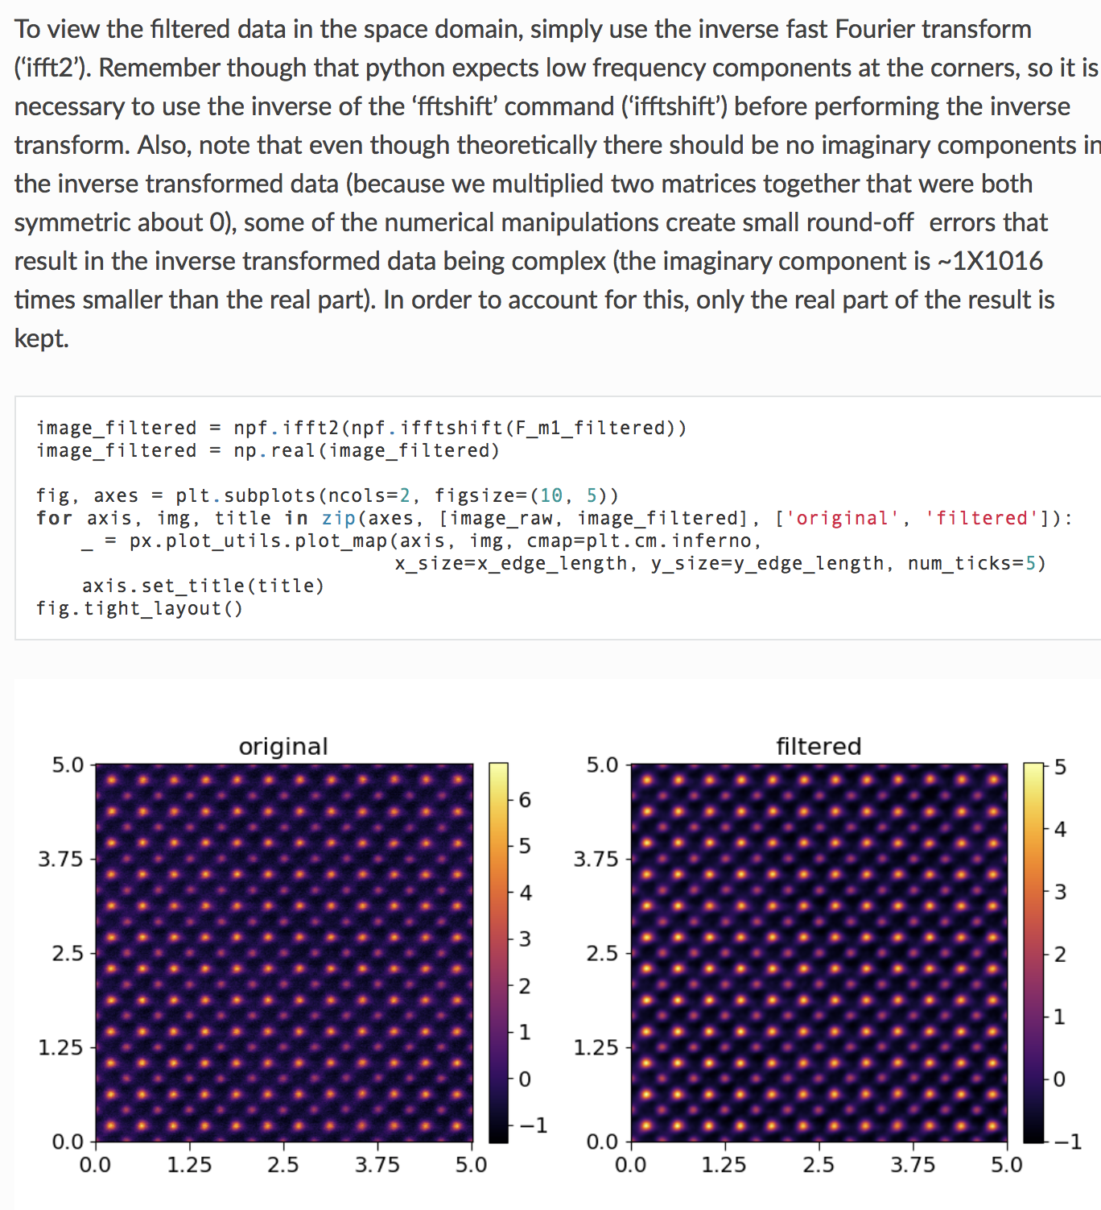
Well documented

Slide 26
Entering the USID Ecosystem
hdf5 file is the hub for all operations
Analysis, processing, visualization available after translation to .hdf5
From instruments
pycroscopy
IO
Visualization
.txt
Translators
Microscope_1,
Spectroscope4,
Camera_X,
…
.ibw
Processing
.mat
Analysis
.dat
.3ds
.hdf5

Slide 27
Jupyter Notebooks
Interactive documents
Exploratory programming
Code
Text
Images
Interactive – slice through data, pan, move, rotate …
Jupyter Notebook

Slide 28
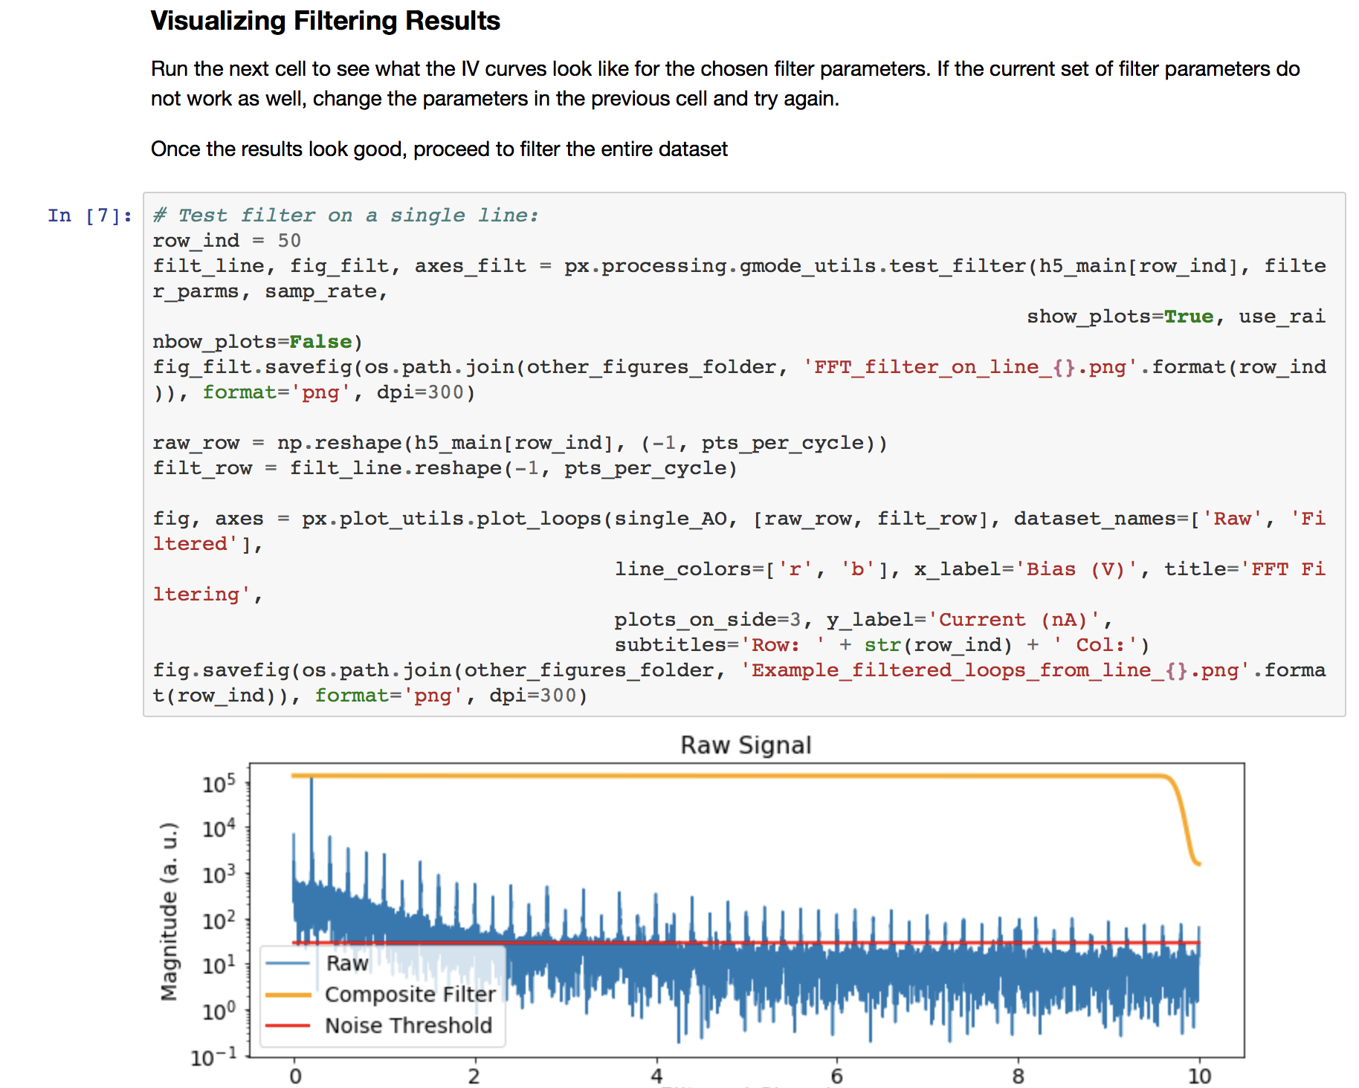
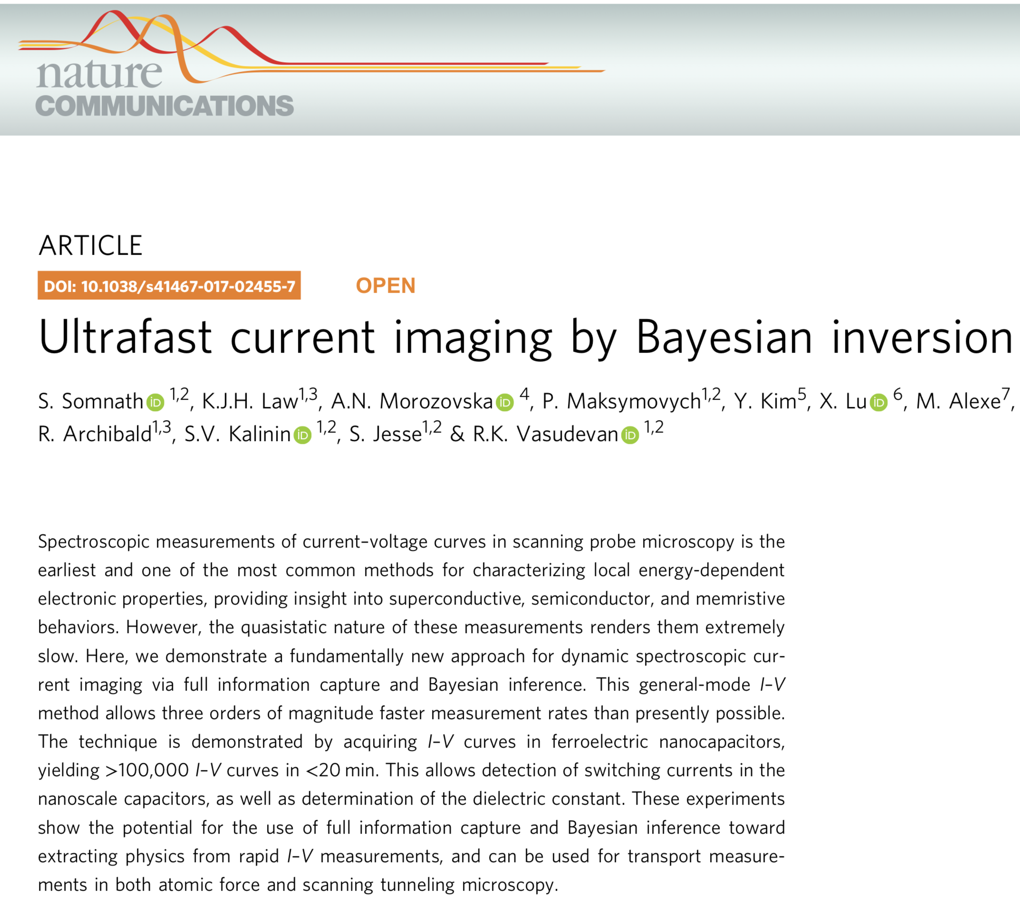
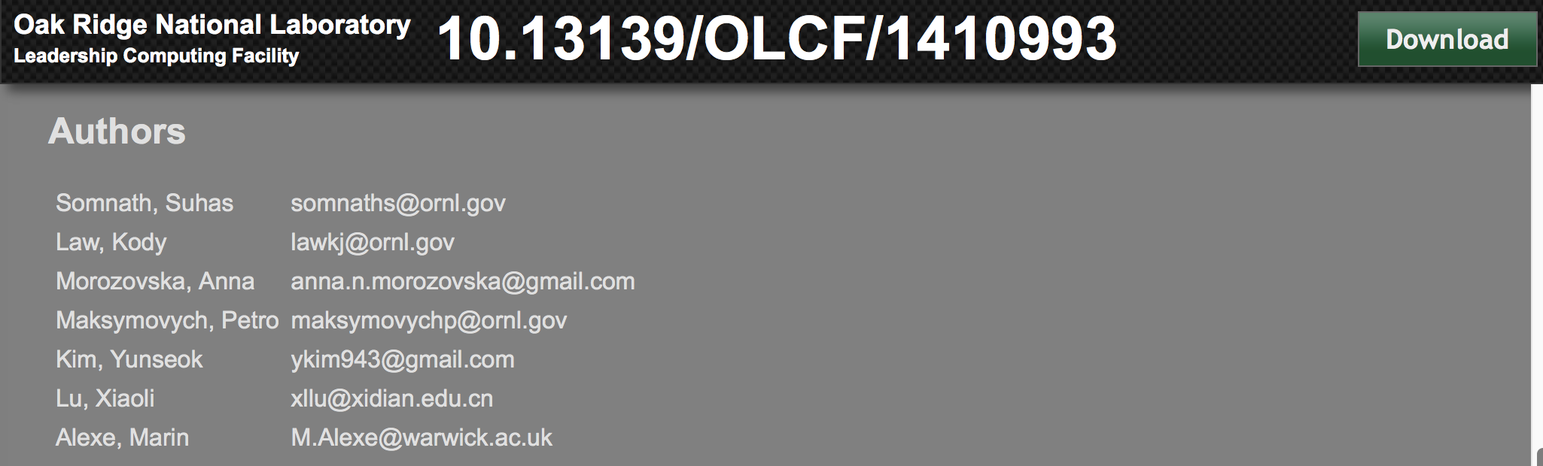
Truly Achieving Open Science, Reproducibility
Jupyter notebook associated with paper
Aim – ALL scientific journal papers accompanied with:
Jupyter notebook that shows all analysis (raw data → figures).
Data with DOI number
DOI associated with data (raw → paper figures)
Notes:
Far better medium for conveying information than conventional alternatives (journal papers or scripts)
Truly interactive data analysis –
see the results of the code immediately
see the code that generated the results

Slide 29

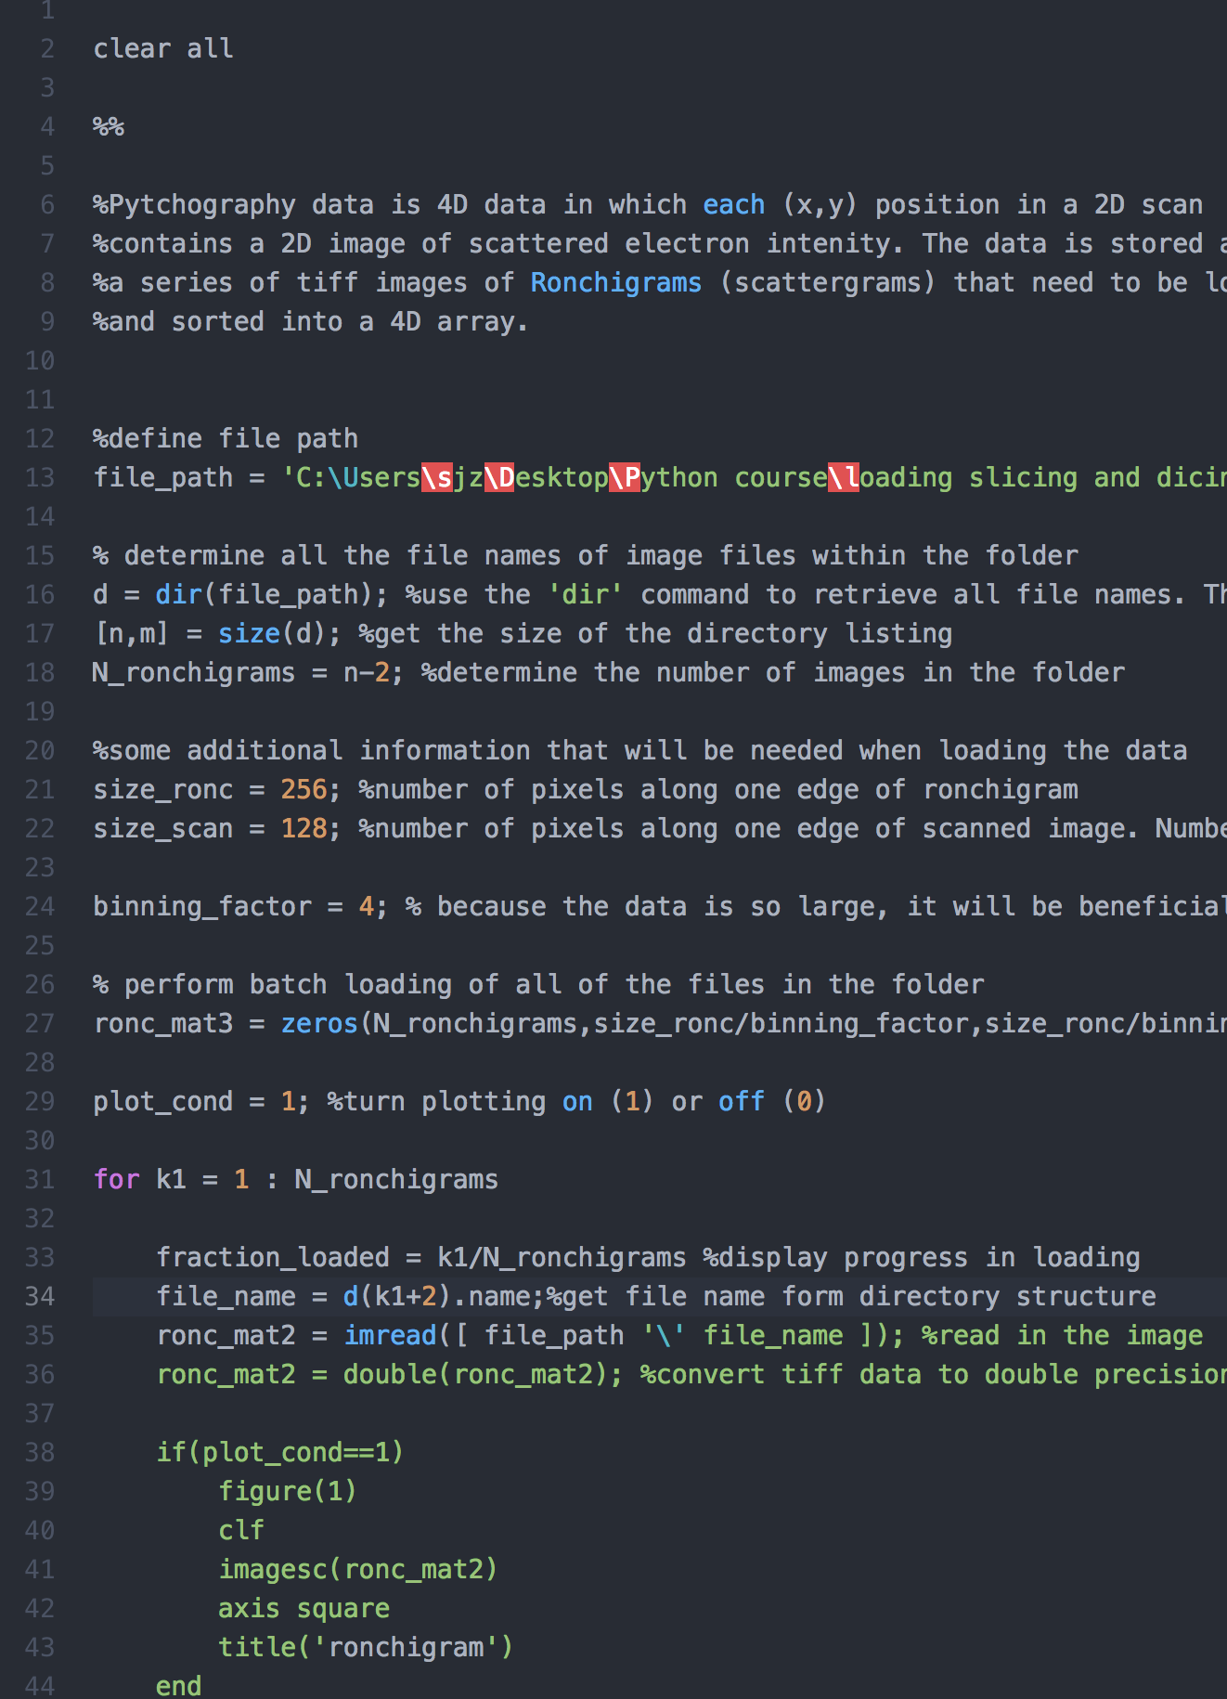
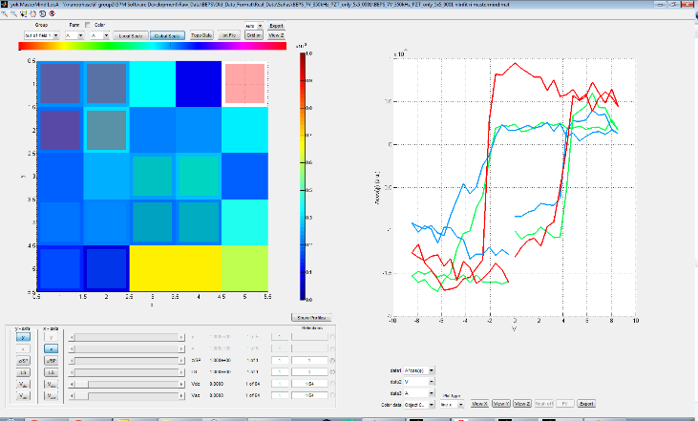
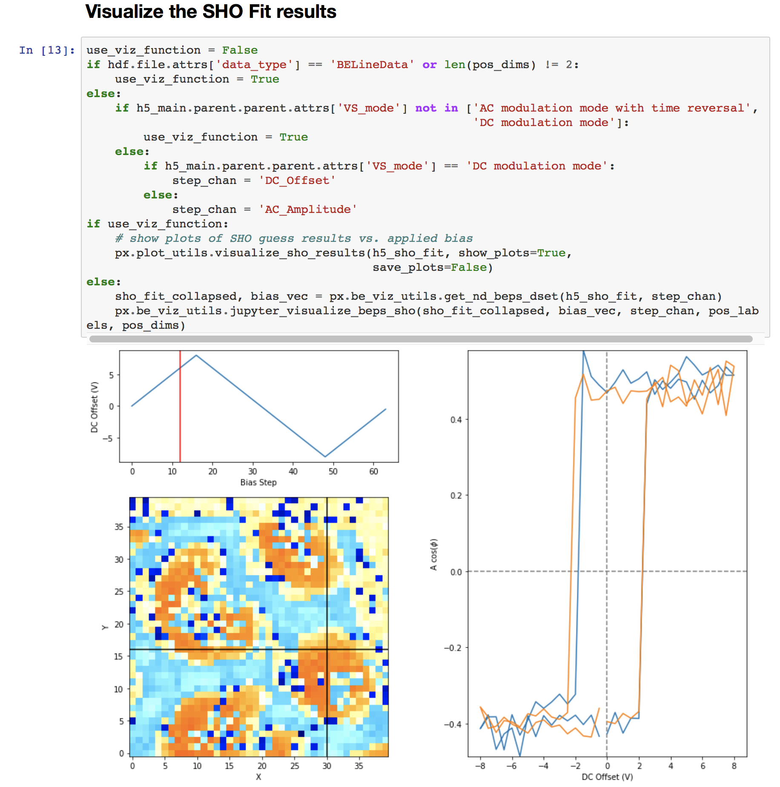
Pycroscopy - Supporting User Research
Before 2016 | Since 2016
Scripts + complicated, Matlab GUI | Set of simple Jupyter notebooks
Witten by dedicated software engineer | Written by material scientists
Not customizable | Completely customizable.
2-3 hours of training before use | Notebooks include instructions. NO training required!
Deployed only on two offline workstations due to licensing restrictions = queue | Each user gets VMs with jupyter notebook server
Will remain on off-line desktops | In the process of switching to computations on clusters
+

Slide 30
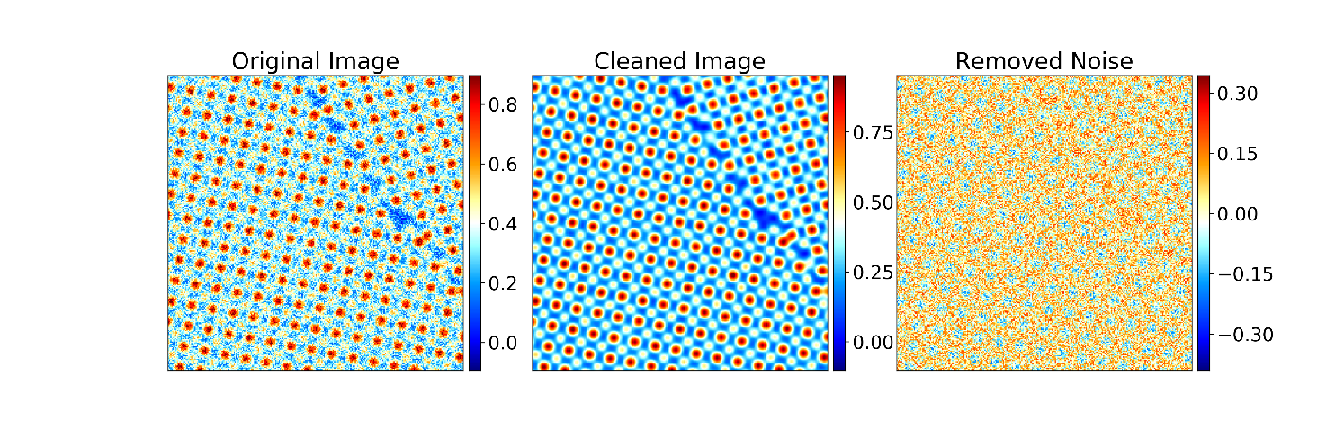
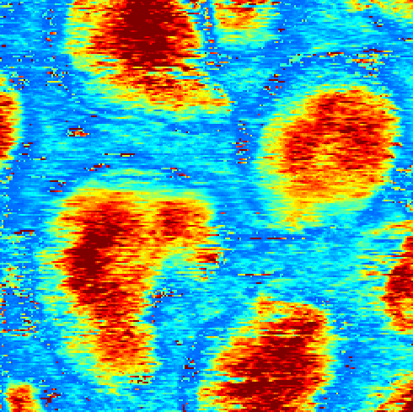
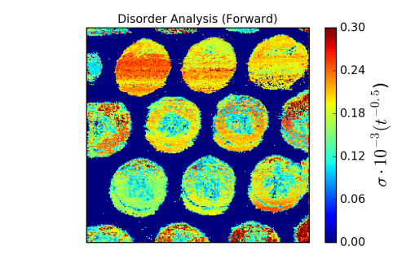
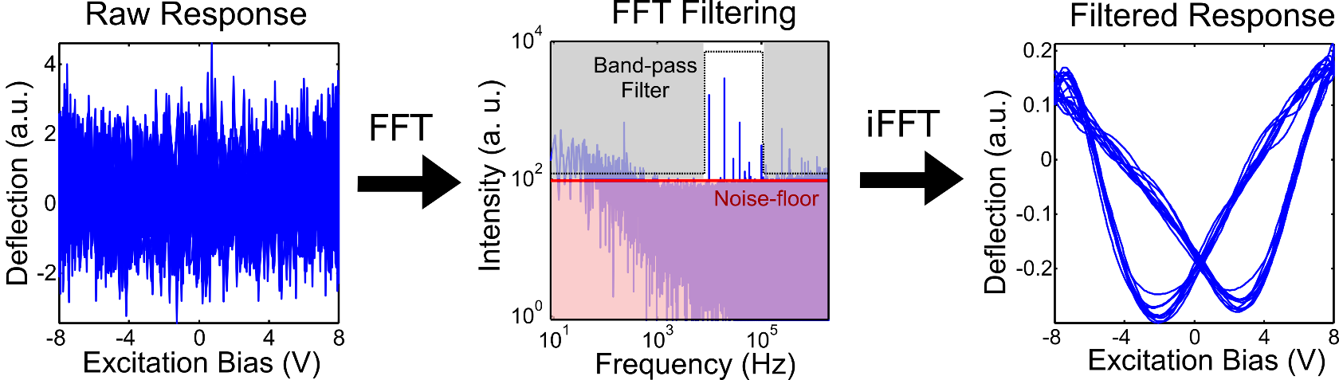
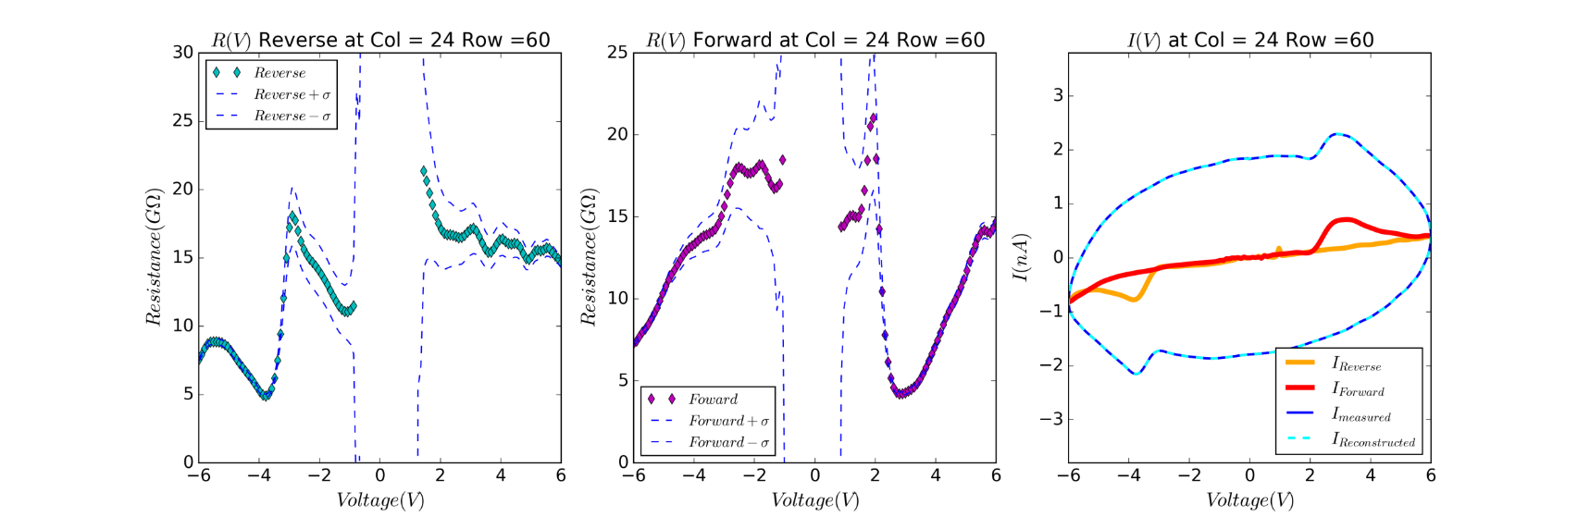
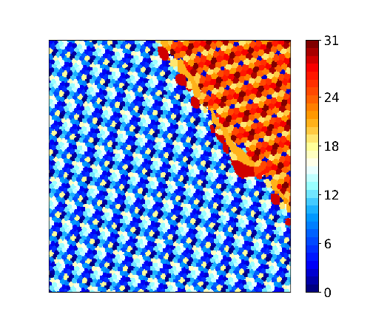
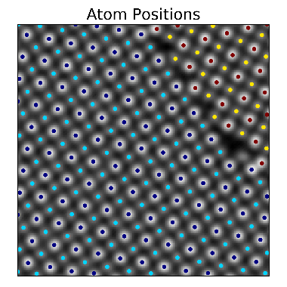
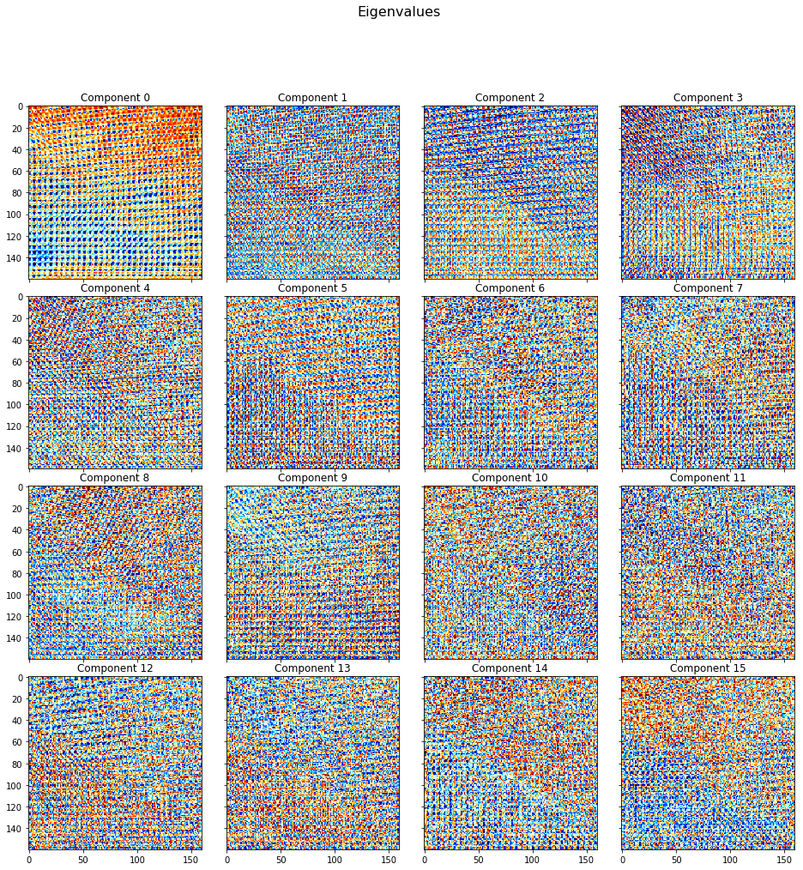
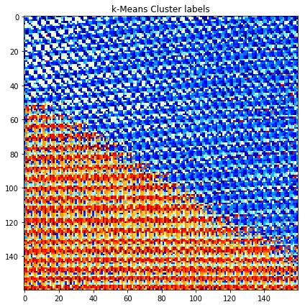
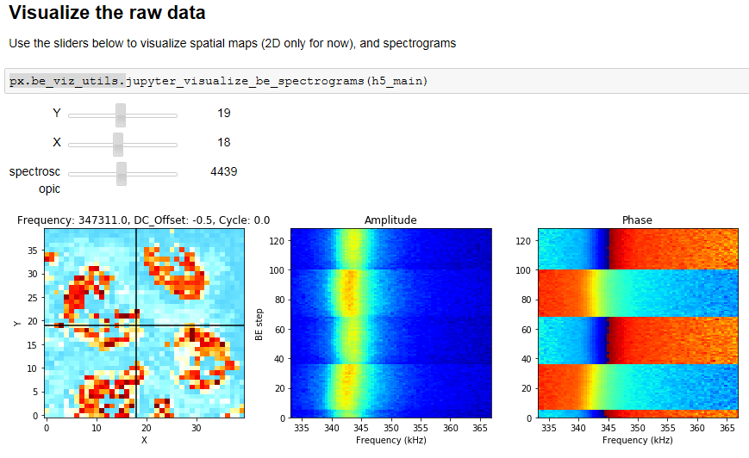
Pycroscopy - Scientific Advancements
200x faster spectroscopy via Bayesian inference
Separating uncorrelated data from correlated data to clean images
3,500x faster imaging via adaptive signal filtering, linear unmixing of signals
Identifying invisible patterns using multivariate analysis
Simplified navigation multidimensional data - users

Slide 31
Software Progression
Scaling up Computing:
2016
Single core
2017
Multi-core
Single CPU
2018
Multi-core
Multi CPU
2019
JupyterHub
On HPC
Emphasis always on ease-of-development instead of raw performance
New Scientific Domains:
+
Mass Spectrometry + Bio-Chemistry
+ Scanning Transmission Electron Microscopy
Atomic Force Microscopy
2016
2017
2018
2019

Slide 32
Thank you
Questions?
File / data tools related- https://groups.google.com/forum/#!forum/pyusid
Science, data analysis, reading proprietary instrument data …. - https://groups.google.com/forum/#!forum/pycroscopy

